Slide 1

PREDICTING MLB GAMES WITH PYTHON
CONNOR ROGSTAD
LAURA MCLAURIN
JOSH BERNARD

Slide 2
FRAMING THE PROBLEM
We located a CSV file from FiveThirtyEight containing information all the way back to the 70s.
We cut down the dataset to include the 2000 season and forward, and that left us with 26 columns and 50,217 rows.
This data shows game-by-game updates of various rating measures for each of the 30 MLB teams.
TOPIC: we wanted to use a sports theme, and found this dataset on Major League Baseball games.

Slide 3
FRAMING THE PROBLEM
We took the data with the goal of developing a model to predict the outcome of a baseball game given the most recent ratings.
We planned two models:
Prediction based on Starting Pitcher
Prediction based on Elo*
Elo is a predictor that accounts for many different variables. It is a power-ranking statistic that estimates current level of skill.
EXPECTATION: pitcher performance and Elo ratings will be good predictors of outcome

Slide 4
Assumptions
The 2020 season ought not be considered in our model
Testing seasons 2000 – 2019 will be sufficient for prediction while maintaining a more current and manageable dataset
TBD is the team code for Tampa Bay Rays (formerly the ‘Devil Rays’)

Slide 5
Success?
Our ML project is a predictive model
Accuracy is measured primarily with the value of R², which shows the extent that X predicts Y
Our original target was 80%

Slide 6
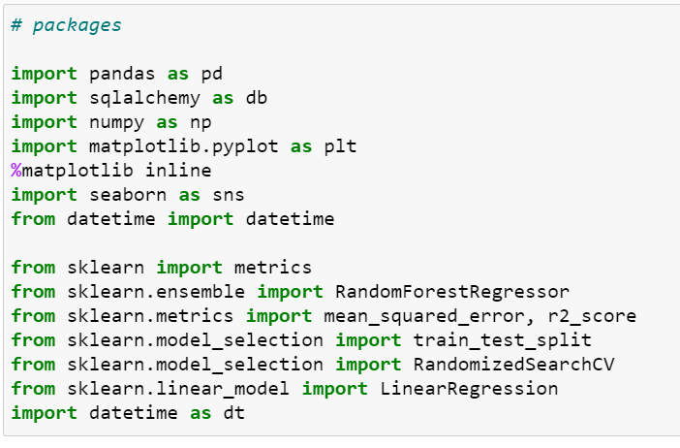
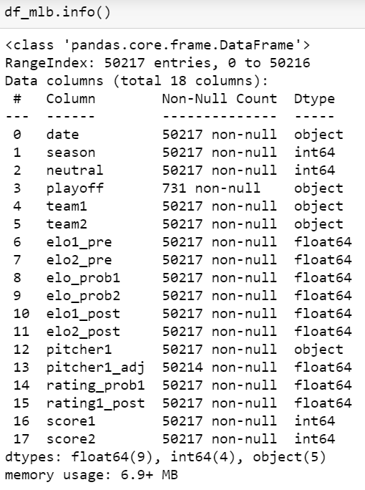
DATA WRANGLING
PACKAGES USED
USE .drop() on 9 columns

Slide 7
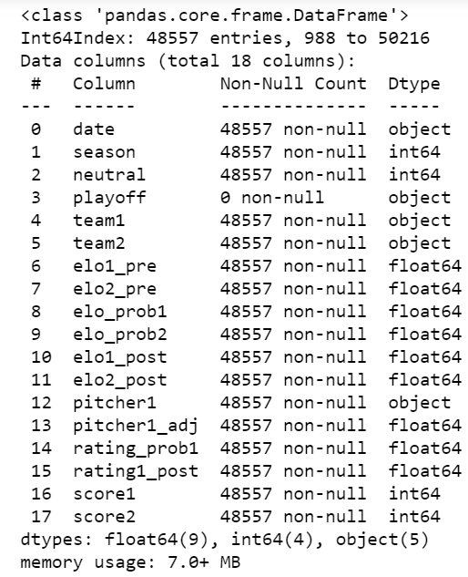
DATA WRANGLING
REPLACE FLOATS WITH THE MEAN VALUES
DROP records with ‘nan’ in playoff column
Delete neutral site games
PLAYOFF | Pitcher1_adj | elo1_post

Slide 8
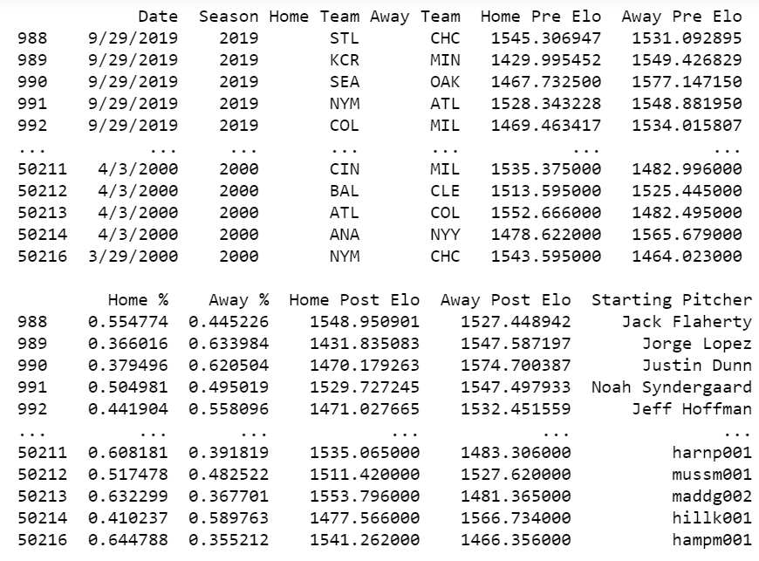
DATA WRANGLING
DROP UNNECESSARY COLUMNS
USE PANDAS TO CREATE A CALCULATED COLUMN
RENAME COLUMNS

Slide 9
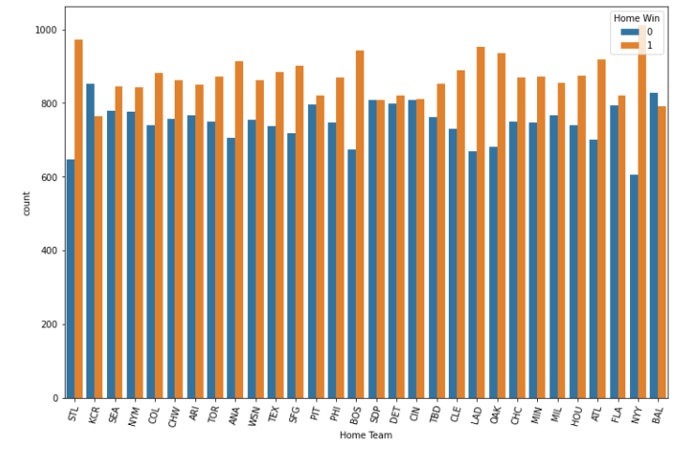
DATA VISUALIZATION
CREATING A COUNT PLOT
X = ‘home team’
LEGEND = ‘HOME WIN’
ROTATE TEAM NAMES 75 degrees
SET THE SIZE AND COLORS FOR win/LOSS

Slide 10
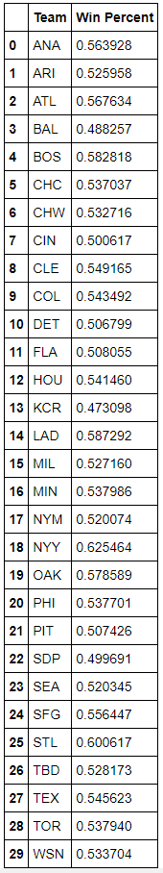
DATA VISUALIZATION
CREATING A WIN% COLUMN
FIND % of total where ‘home win’ = 1 with value_counts
Create a dict with each team name & win%
RENAME as win_pct

Slide 11
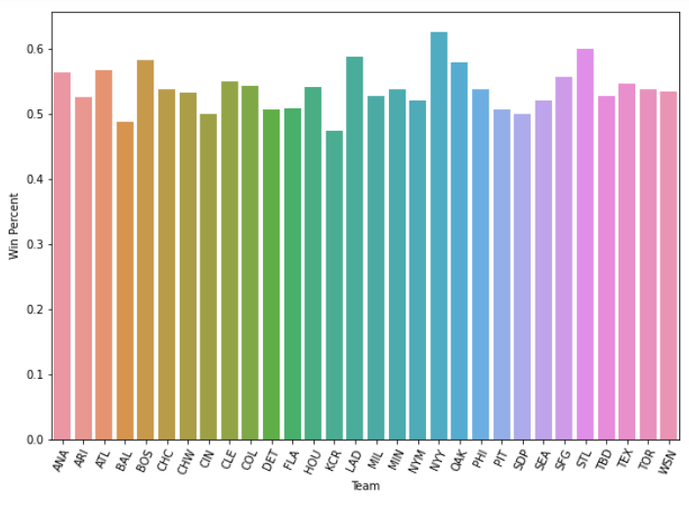
DATA VISUALIZATION
CREATING A BAR GRAPH
NORMALIZE home win count per team relative to the mlb
Define X & Y, rotation, fontweight & size

Slide 12
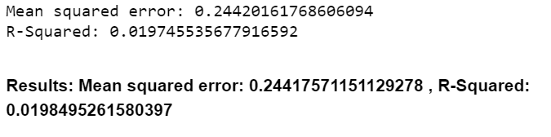
DATA MODELING—Pitcher
CREATING OUR TRAIN & TEST SETS
DEFINE X & Y AS ‘starting pitcher win%’ & ‘home win’
USE TRAIN_TEST_SPLIT to create a train set of 10%
RUN FIRST RANDOMFOREST and fit with train sets
Y_pred to calculate MSE & r2

Slide 13
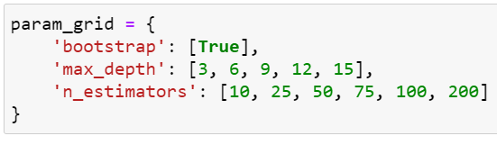
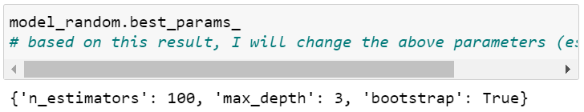
DATA MODELING
FINDING optimal parameters
Use param_grid to set parameters to set for depth & # of trees
Define the random model and fit it with the train sets
Use best_params to find our parameters

Slide 14
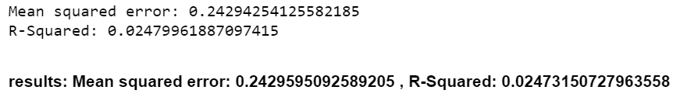
DATA MODELING
ADDING 1 variable TO OUR X VARIABLE
X2 = ‘start. Pit. win %’ & ‘Start. Pit. Rating’
RUN a new split using x2, retrain the model & use y_pred2
FIND our new mse & r2

Slide 15
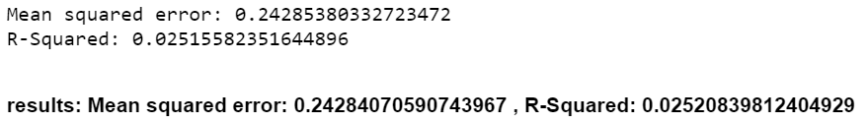
DATA MODELING
ADDING 2 variables TO OUR X VARIABLE
X3 = ‘start. Pit. win %’ , ‘Start. Pit. Rating’ , ‘Home win %’ & ‘Start. Pit. Adj.’
RUN a new split using x3, retrain the model & use y_pred3
FIND our new mse & r2

Slide 16
Pitcher model… not so great
0.025 is the best R² we’ve got with the pitcher stats

Slide 17
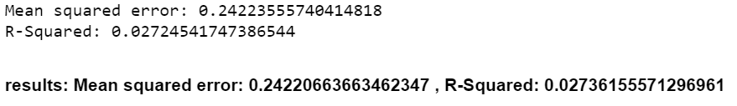
DATA MODELING—Elo
DEFINING A Different ‘Z’ Variable
Z = ‘Home Post elo’ & y = ‘Home win’
Split the new train and test using Z and Y
Fit new “elo” model with Z and Y train sets
USE Y_pred to find this MSE & r2

Slide 18
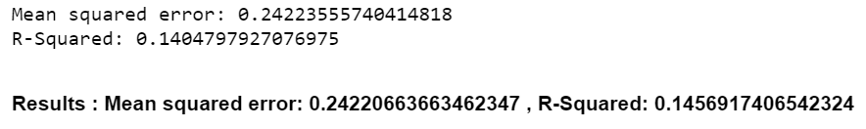
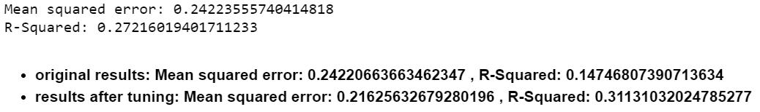
DATA MODELING
ADDING to our Z variable
Z2 = ‘Home post elo’ & ‘home pre elo’
Z3 = ‘Home post elo’ , ‘home pre elo’ , ‘home %’

Slide 19
Elo model: much more promising
Utilizing pre- and post- game Elo, we were able to get an R² of about 0.14 right off the bat

Slide 20
TUNING THE MODELS
We will tune our best-performing model, Elo pre/post + Home Win
We created one more model that adds in the Pitcher Rating and Win % with that pitcher starting
We use the Randomized Cross-Validation Search technique to look for the best parameters, then change the inputs to the Random Forest to check for optimal results

Slide 21
TUNING THE MODELS
Tuning our model using Z3:
The RandomCV suggests 50 estimators from the input list, however 25 consistently gives a higher result
Increasing max depth continually increases the result… we decided that a depth of 6 was reasonable while sill providing high performance
With a depth of 6, the optimal number of estimators is 11 trees
After tuning the hyperparameters, this model yields an R² of 0.3113
MSE = 0.2163

Slide 22
TUNING THE MODELS
Tuning the Combination Model:
The original result of Elo + Pitcher was R² = 0.132
Following a similar method, we chose a depth of 6 and found 29 trees to be the optimal number of estimators
After tuning the hyperparameters, this model yields an R² of 0.3149
MSE = 0.1706

Slide 23
Big Picture
We achieved upwards of 31% accuracy with two of our models
These models are not prolific for predicting the outcome of MLB games, but still offer insight into the significance of pitcher rating and Elo

Slide 24
Conclusion
To pick a winner… Elo with 3 variables is our best model
We choose this one because the results between the top 2 are close, but the Elo-only version can achieve comparable results with less resources
A more efficient model provides a better business solution for companies dealing with massive datasets by saving time and computing space

Slide 25
Comments
Notes:
RandomizedCV Search was not helpful…?
The dataset likely did not include enough relevant points of observation to make a trustworthy prediction model

